Slide 1
CORPORATE EVENT MANAGEMENT
DAWAT

Slide 2
WHY CHOOSE DAWAT FOR YOUR CORPORATE EVENT
DAWAT has collaborated with world renown international and local clients to successfully market and launch products throughout Pakistan.
Professionally executed events are the perfect platform to link knowledge with emotion to deliver memorable messages. There is no limit to what can be done. Call us to discuss your objectives and we will provide creative, impressive and cost effective solutions every time.
Whether launching a brand, a business or a product, the basic principles are the same. You will only get one opportunity to create a powerful affinity with your target audience.

Slide 3
OUR SUCCESS STRATEGY
Creativity
Briefing
Evaluation
Strategy
Execution

Slide 4
1. PRODUCT LAUNCHES & BRAND ACTIVATION
First Impression is the Most Important

Slide 5
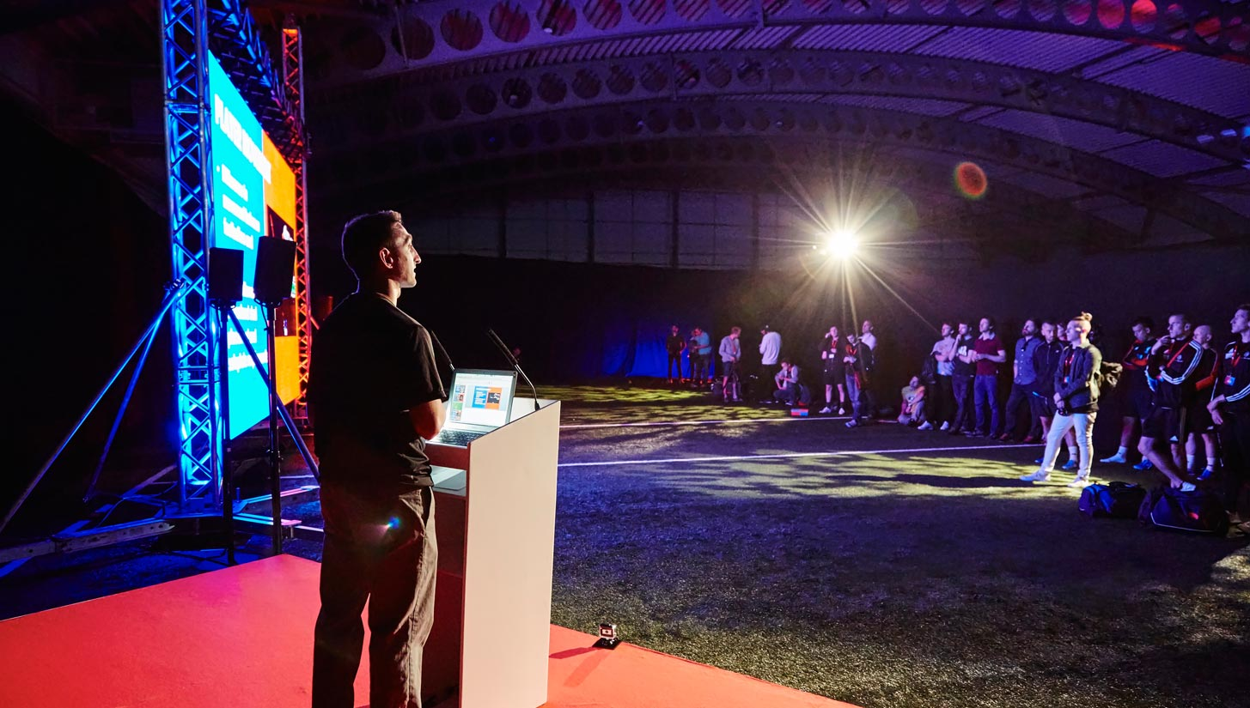
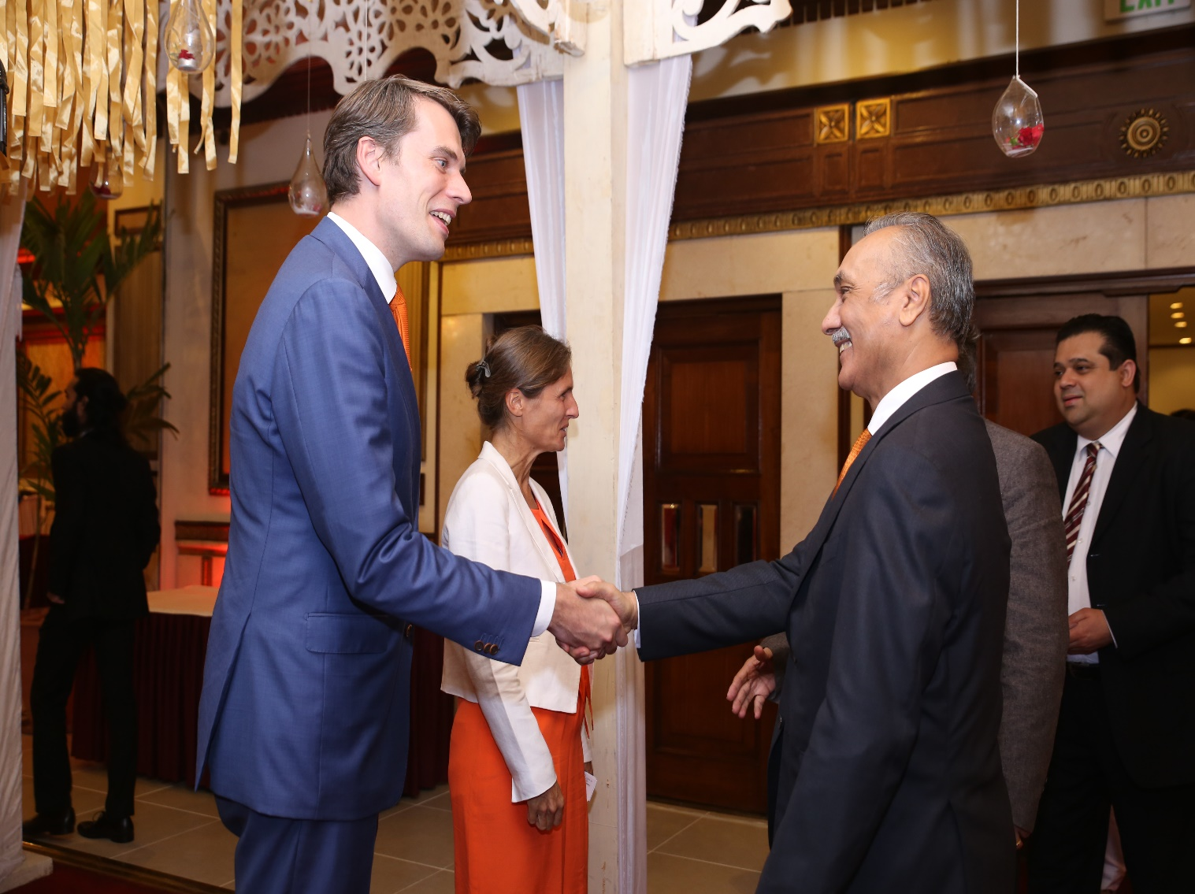
PRODUCT LAUNCHES & BRAND ACTIVATION

Slide 6
SERVICES PROVIDED
Venues and catering
Audio visual requirements
Staging and theming
Branded signage
Customized flags and banners
Branded staff uniforms
Promotional gifts and items
Pre and post event marketing
Media liaison and logistics
Media materials and press kits
Media room requirements
Photography and videography
VIP and celebrity management
Stunts and surprises

Slide 7
2. EXHIBITIONS & TRADESHOWS
Customer Interaction is Vital

Slide 8
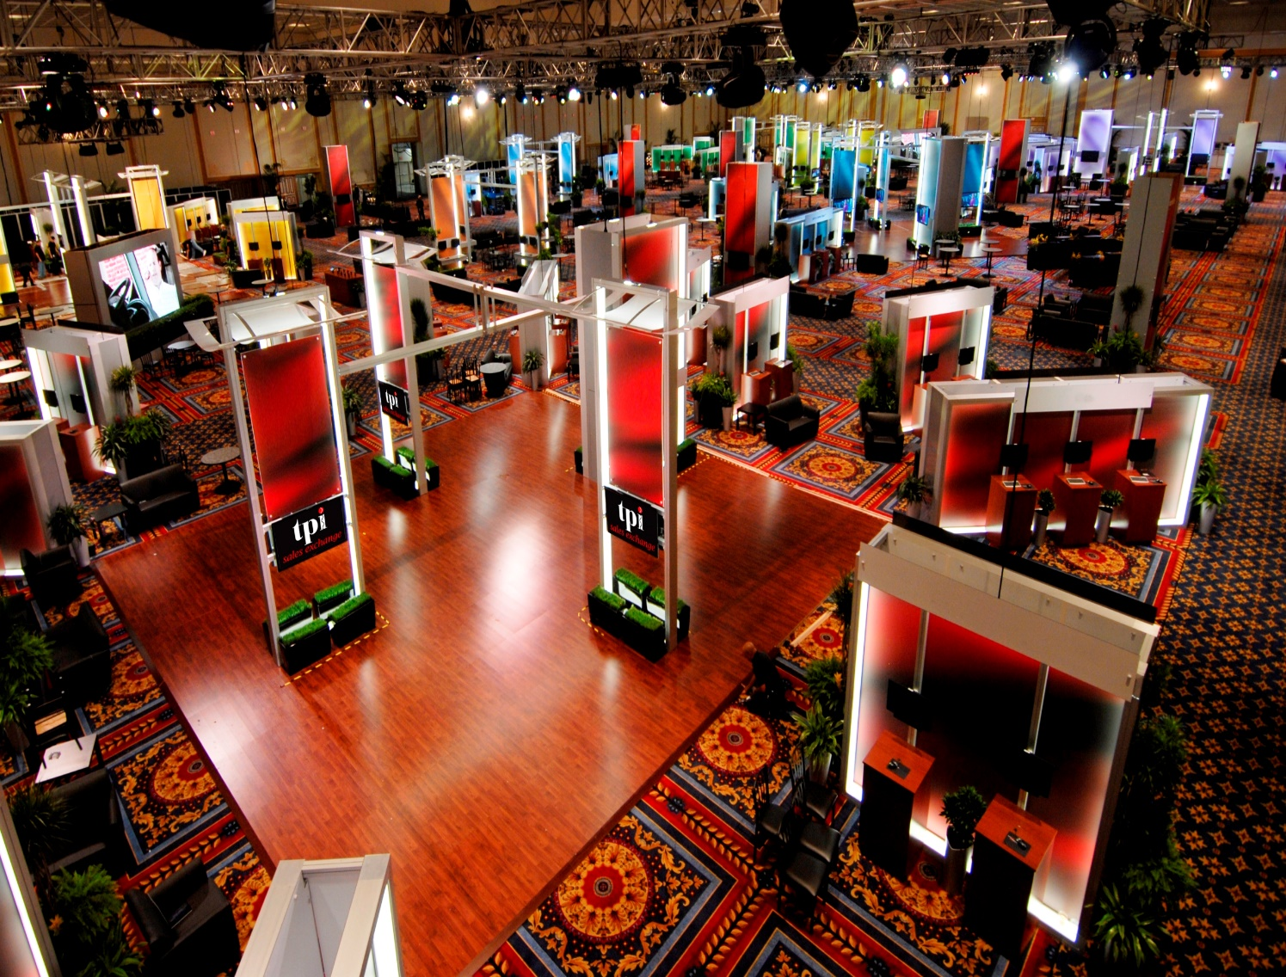
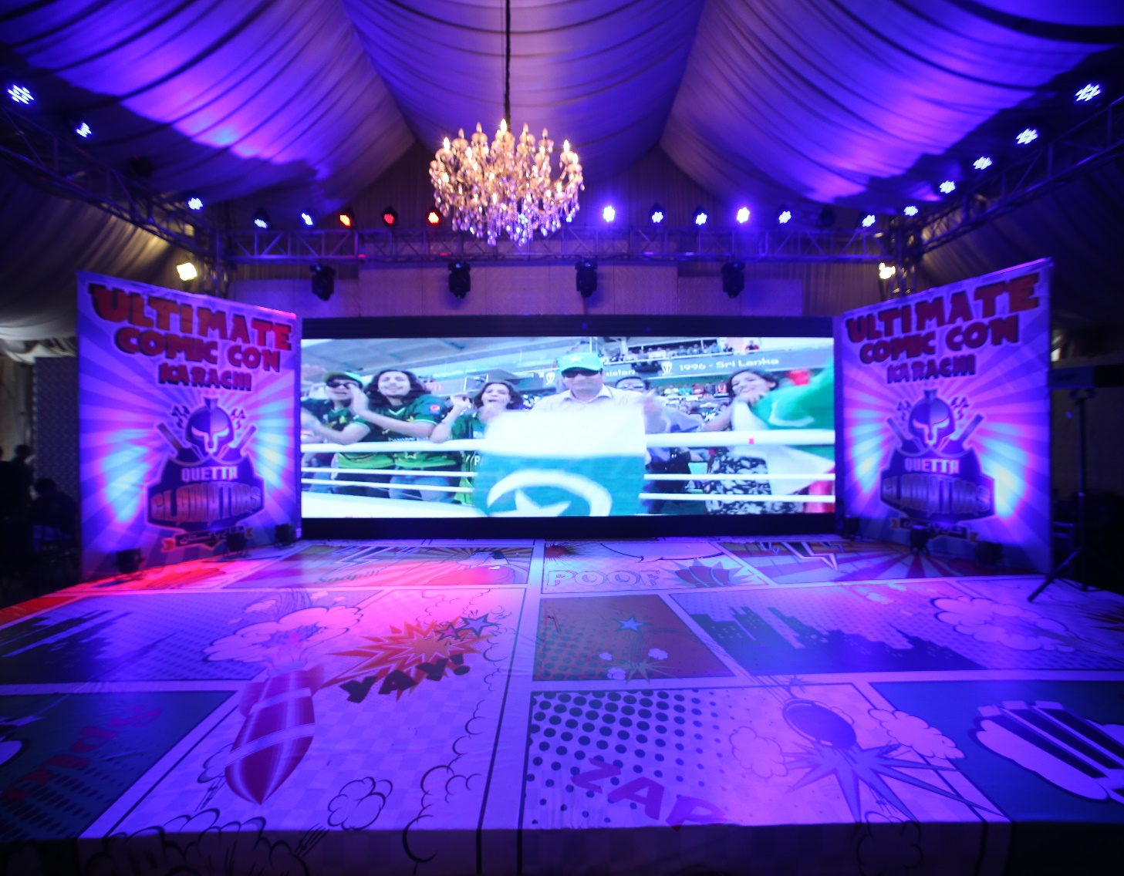
EXIHIBITONS & TRADESHOWS

Slide 9
SERVICES PROVIDED
Venues and catering
Stand concept and design
Construction and installation
Furniture and equipment
Audio visual design and supply
Signage and branding
Program and collateral production
Name badges and lanyards
Promotional items and gifts
Onsite promotional staff
Award presentations and prizes
Pre and post event communications
Post event evaluation

Slide 10
3. GOVERNMENT SUMMITS & EVENTS

Slide 11
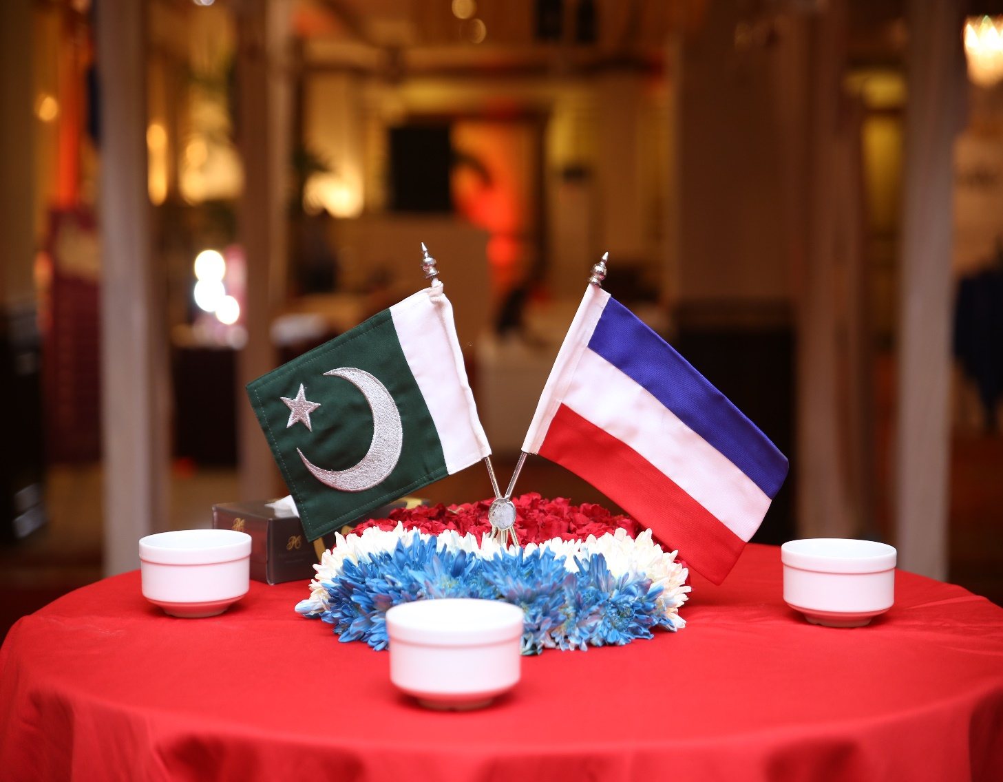
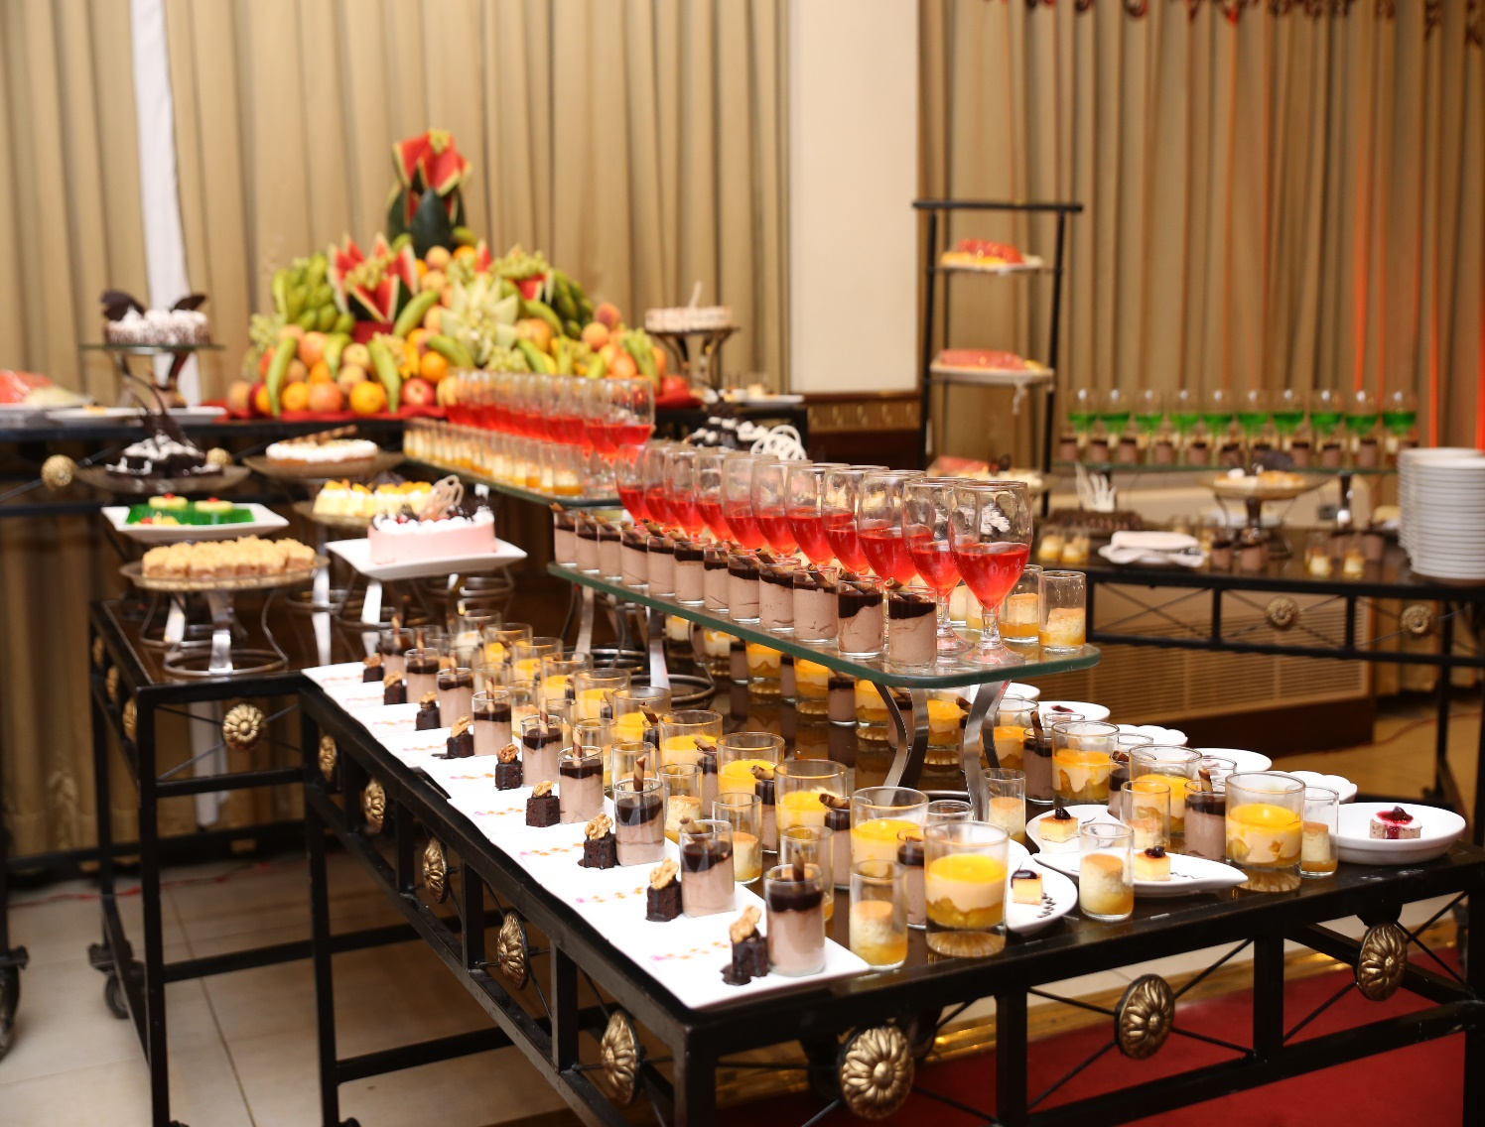
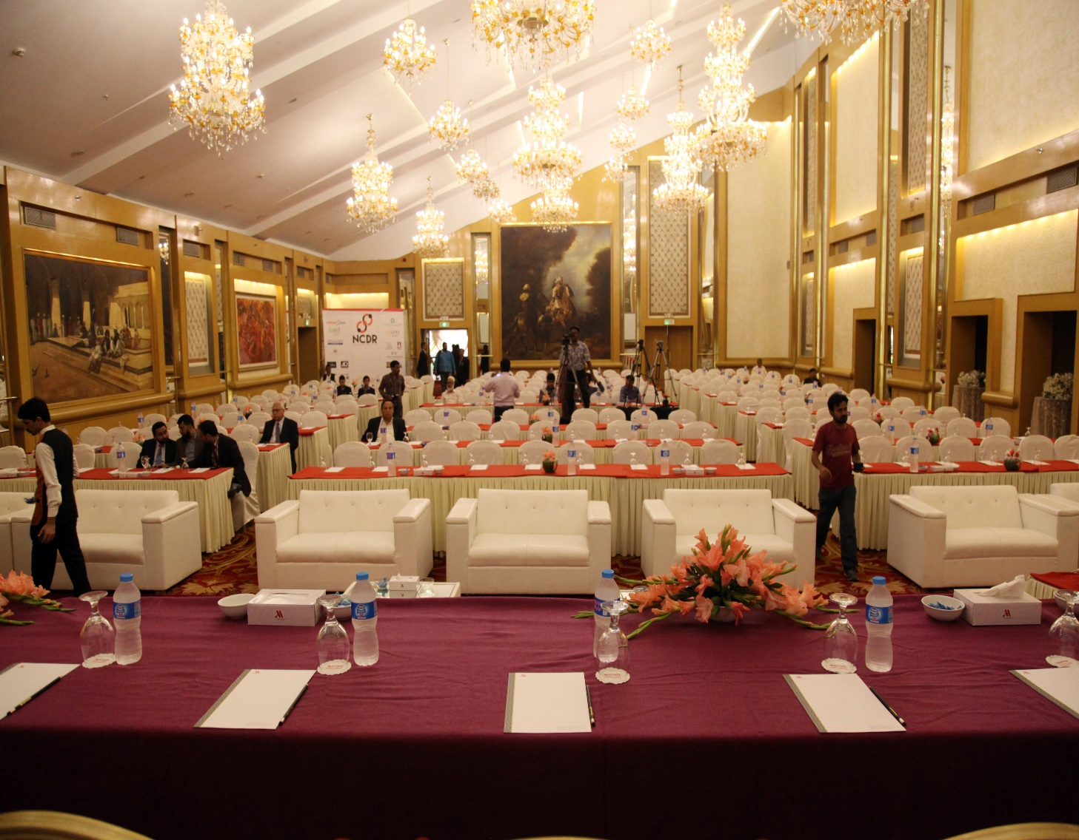
GOVERNMENT EVENTS

Slide 12
SERVICE PROVIDED
Strategic project planning and guidance
Multi-stakeholder management
Media management and liaison
Cross Department coordination
Conference website and communications
Pre and post event marketing
Venue negotiation and liaison
Catering management
Stage and set design
Audio visual requirements
Invitation and registration management
Speaker management
Delegate management
Signage and branding
Program and collateral printing
Name badges and lanyards
Conference accessories
Exhibition management
Sponsorship management
Social event arrangements
Onsite staffing and show calling
Travel and accommodation
Photography and videography
Transportation and storage
Risk management and security
Post event evaluation and report

Slide 13
COMPLETE MARKETING PACKAGES
SMS MARKETING
EMAIL MARKETING
PRINT MARKETING

Slide 14
LIST OF CLIENTS WE HAVE WORKED WITH

Slide 16
OUR PROCESS IS EASY
CALL
CONSULT
CONFIRM
CELEBRATE

Slide 17
Maps
COME VISIT US!
OUR OFFICE, SHOP # G-22 OCEAN MALL ,CLIFTON, KARACHI

Slide 18
CONTACT US!
Email
Info@Dawatpk.com
Phone
021-35166550-1/ 0335-7888038/ 0335-7888061

Slide 19
NOTHING BUT PERFECTION
At DAWAT figuring out an innovative and effective way to create a lasting bond between customers and the corporations is what we strive for.
We believe in the “keep it simple” approach. We start at the beginning and take the time to listen and understand your brief, your brand and your goals. We will work with you to design, manage and deliver modern and meaningful communications strategies, which are tailor-made to achieve your key objectives.

Slide 20
THANKS!

